Slide 1
Business Need for the Park Company
- Objective: Park Company needs to modernize its website to enhance the customer experience and increase engagement for parking services.
- Current Challenges:
- User Experience Issues: The current website has limited search functionality and is not fully responsive across devices.
- Outdated Reservation System: Users cannot easily reserve and pay for parking online, impacting customer convenience.
- Limited Real-Time Data: Lack of integration with Park Service’s backend system prevents displaying live parking availability and pricing.
- Solution Goals:
- Provide a modern, responsive, and user-friendly website.
- Enable users to search, reserve, and pay for parking spots online.
- Integrate real-time parking data for availability and pricing, improving user trust and service efficiency.

Slide 2
Project Benefits
- Improved User Engagement:
- A user-friendly, responsive design will increase accessibility and engagement across devices.
- Increased Revenue:
- Enabling reservations and payments online will attract more users, leading to higher conversion rates and customer retention.
- Enhanced Operational Efficiency:
- Integrating real-time data will reduce manual data entry and administration for Park Company staff.
- Competitive Advantage:
- Modernizing the website gives Park Company a stronger online presence and keeps them competitive in the parking industry.

Slide 3
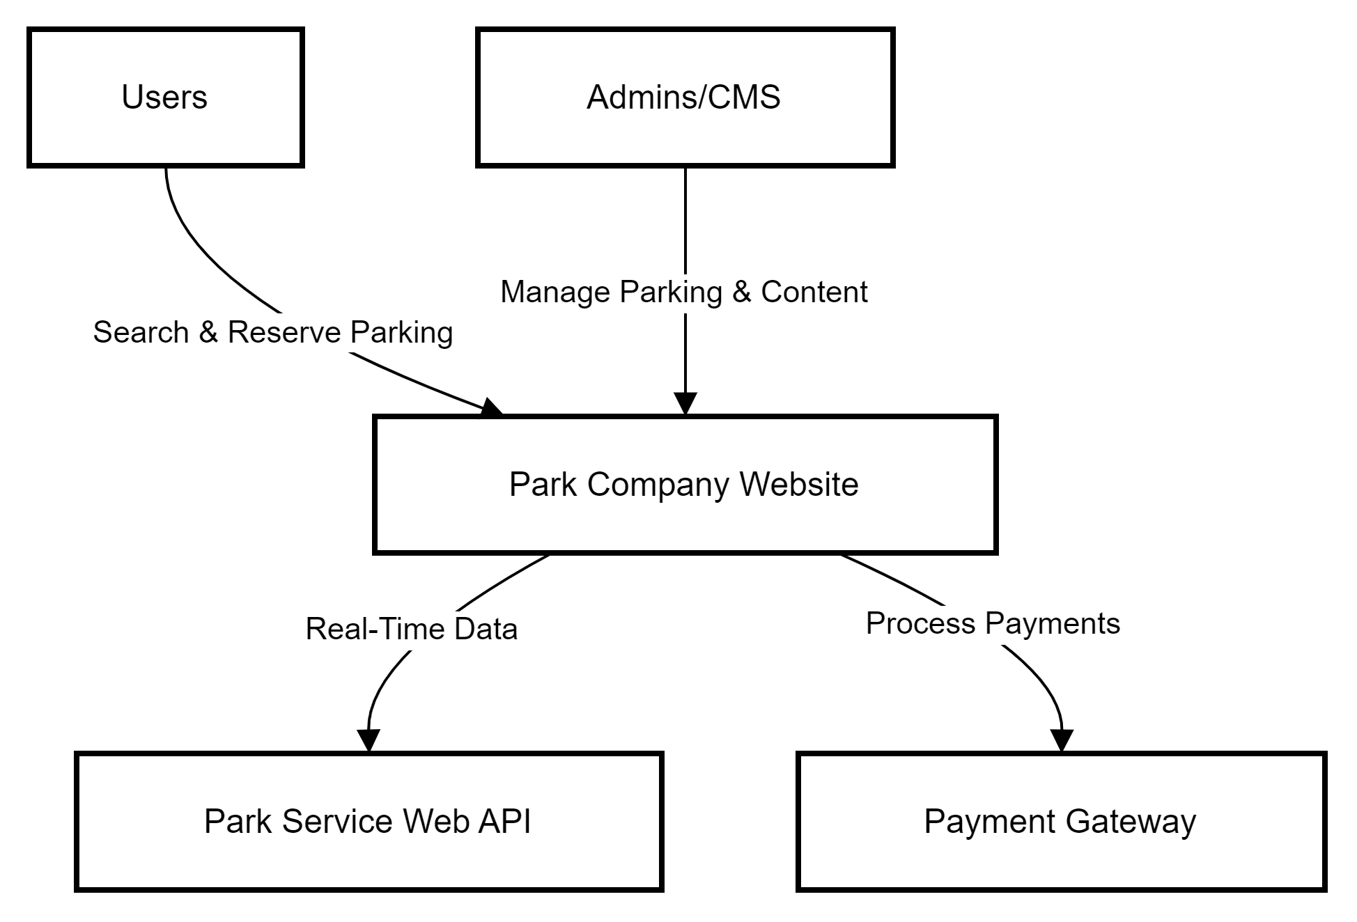
Context Diagram
- The Park Company Website is the central hub for users and administrators.
- Users interact with the website to search for parking, make reservations, and complete payments.
- Park Service Web API supplies the website with up-to-date parking availability and pricing information.
- The Payment Gateway processes transactions, ensuring secure online payments.
- Administrators access the CMS to update parking data, ensuring users see accurate information.

Slide 4
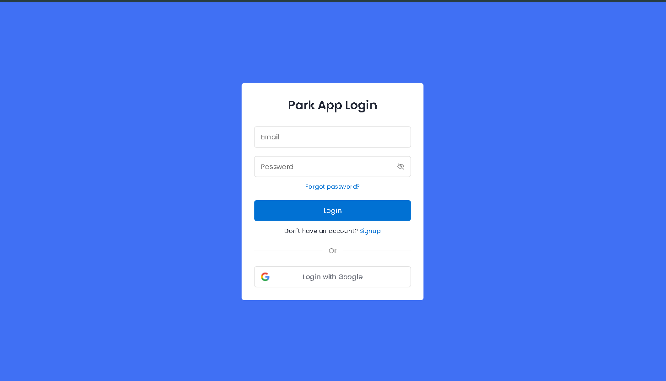
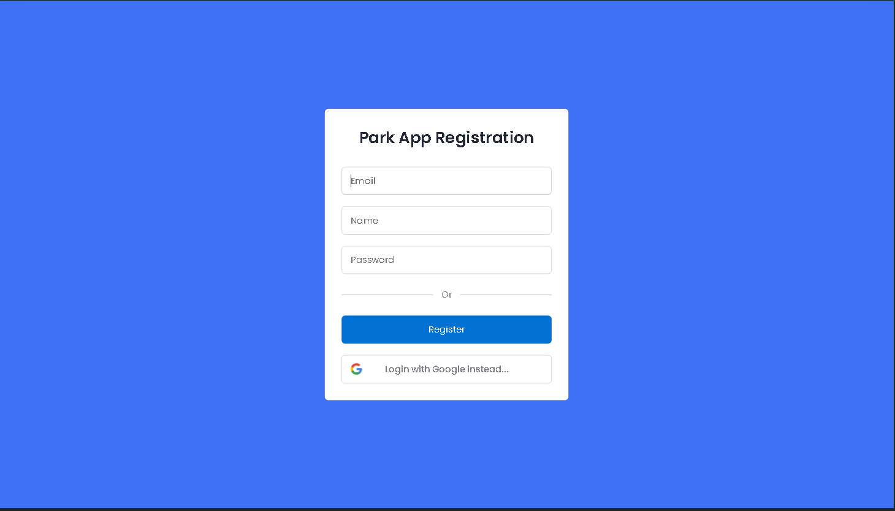
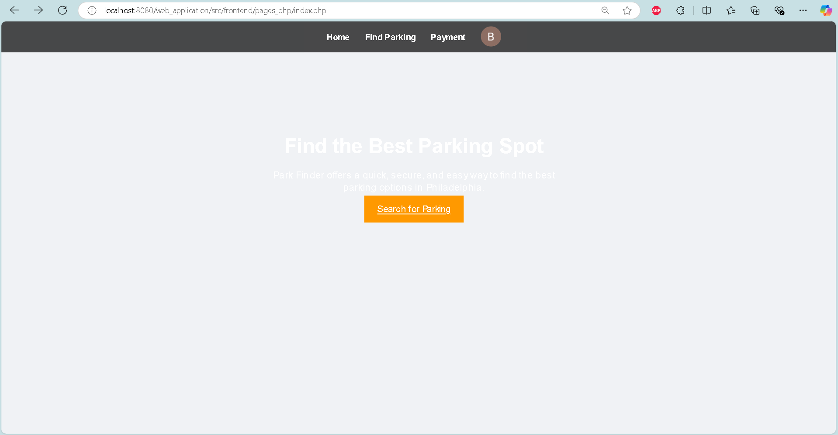
UI/UX Wire Frames

Slide 5
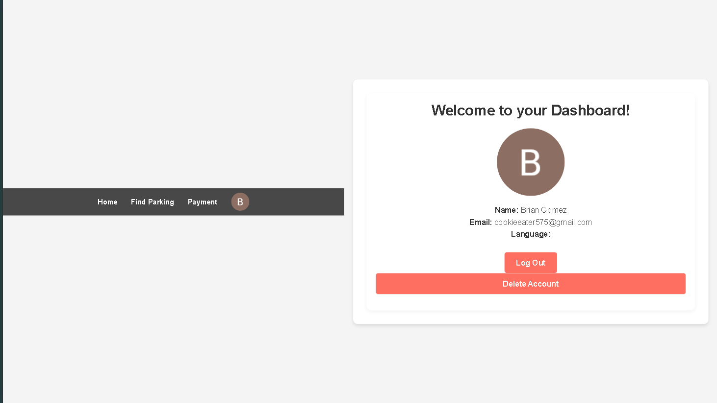
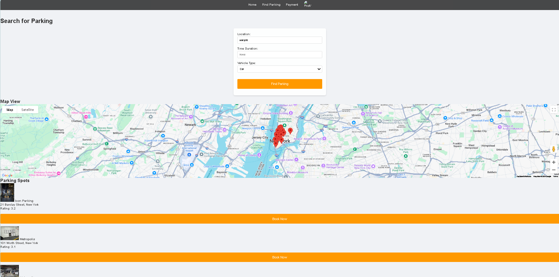
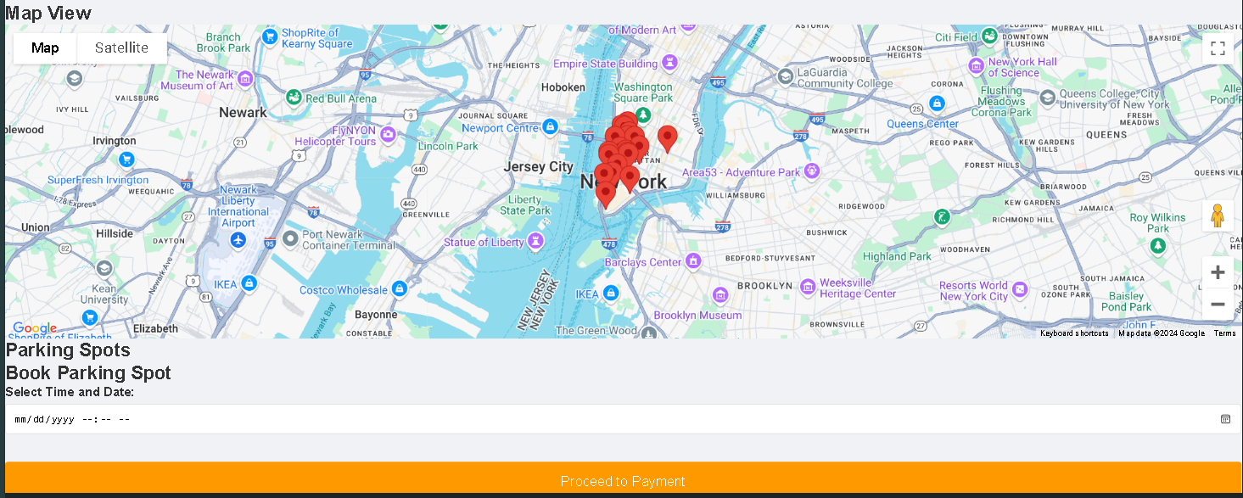

Slide 6
